Slide 1
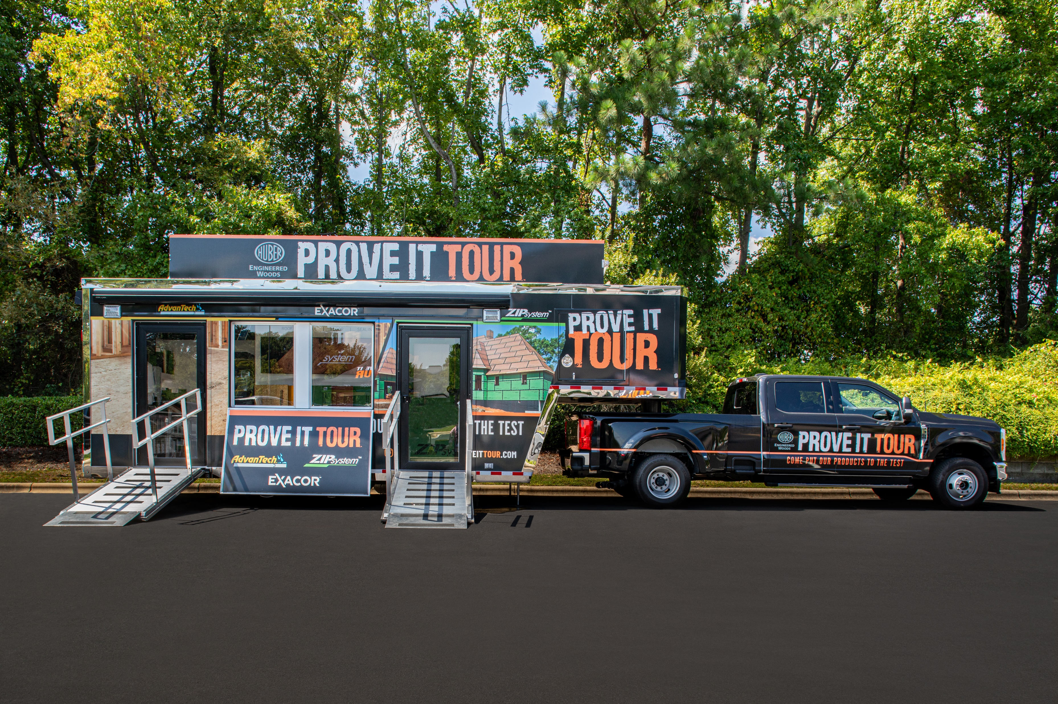
SITE OF EVENT
STREET NAME
CITY, STATE ZIP CODE
MONTH, DATE, YEAR
00:00AM/PM - 00:00AM/PM
BREAKFAST/LUNCH PROVIDED
PUT OUR PROVEN BRANDS TO THE TEST
Advantech™ Subflooring
Advantech™ Subfloor Adhesive
Advantech X-Factor™ Subflooring
ZIP System™ Sheathing & Tape
ZIP System™ R-Sheathing
ZIP System™ Accessories Products
EXACOR™ MgO Underlayment
COME TO A PROVE IT TOUR™ EVENT RECEIVE A FREE PRODUCT SAMPLE
*Limit 1 free product per customer. While supplies last. Free Product received following completion of survey
Join us at our next event! www.ProveItTour.com
© 2024 Huber Engineered Woods LLC. AdvanTech, ZIP System, EXACOR and the accompanying logos
are trademarks of Huber Engineered Woods LLC. Huber is a trademark of J.M. Huber Corporation. HUB 81800 REV 12/23

